Slide 1

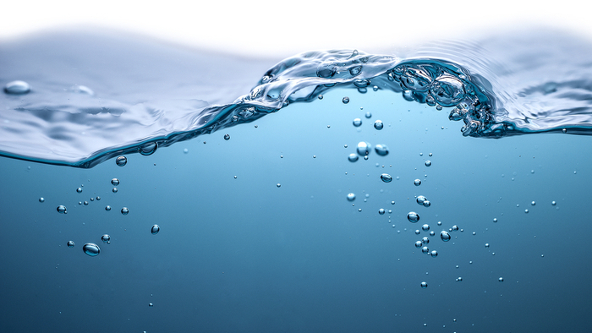
Predicting Water Potability
Dataset: https://www.kaggle.com/adityakadiwal/water-potability

Slide 2

Summary
15 Models
High Accuracy - Elusive
Best - Random Forest
Business Rules
Next Steps

Slide 3
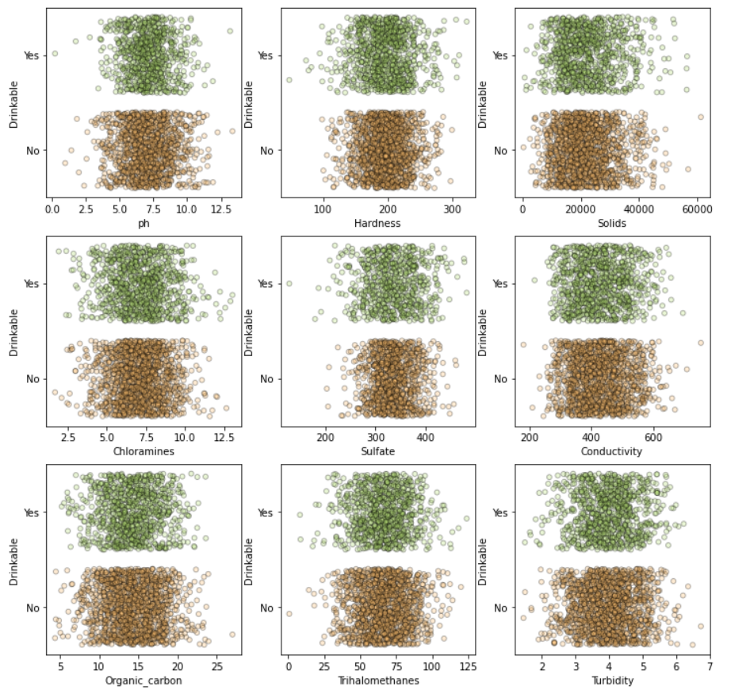
Intro to Data
≈ 3,500 observations
different bodies of water
No relationship visually identified
Missing values:
Missing Trihalomethane significant
Imputing Strategy: mean ≈ median

Slide 4
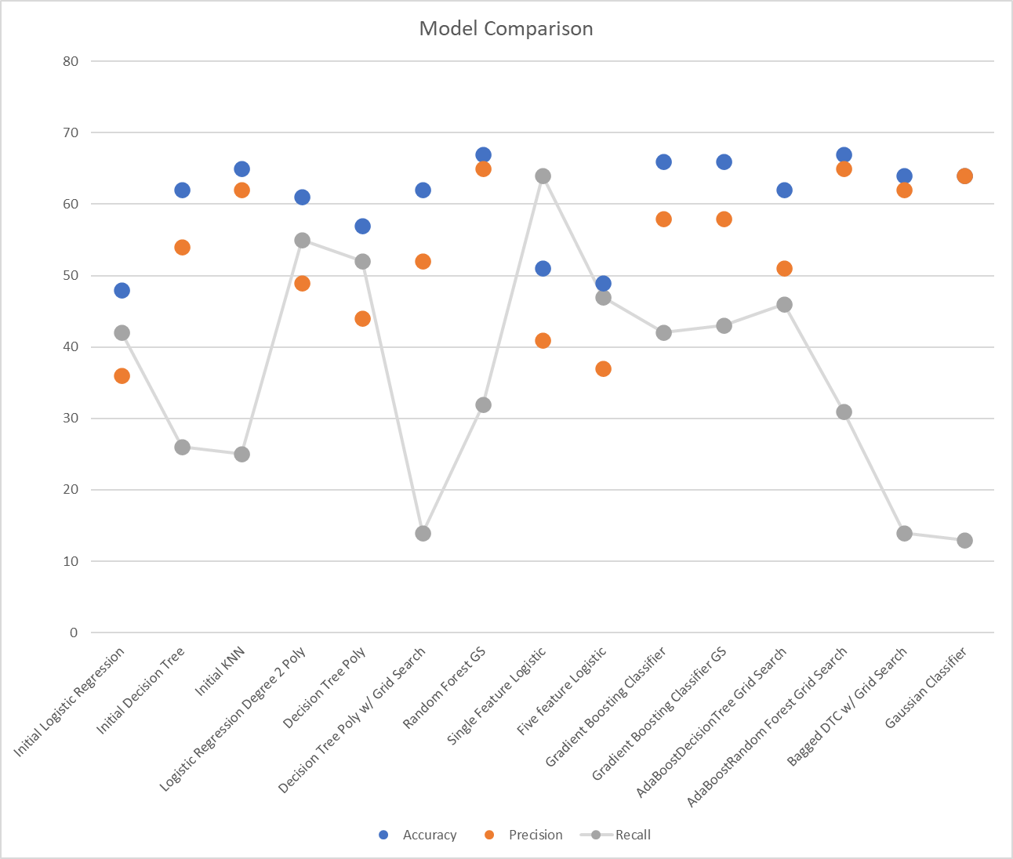
Models Comparison
15 Models
Manual Tuning
Grid Searched Tuning
Reduce False Positives - poison
Recall at Cost of Accuracy, Precision

Slide 5
Best Model
Grid Searched Random Forest
65% of positives are true
30%+ of true positives are found

Slide 6
Holdout Results
Nice to have

Slide 7
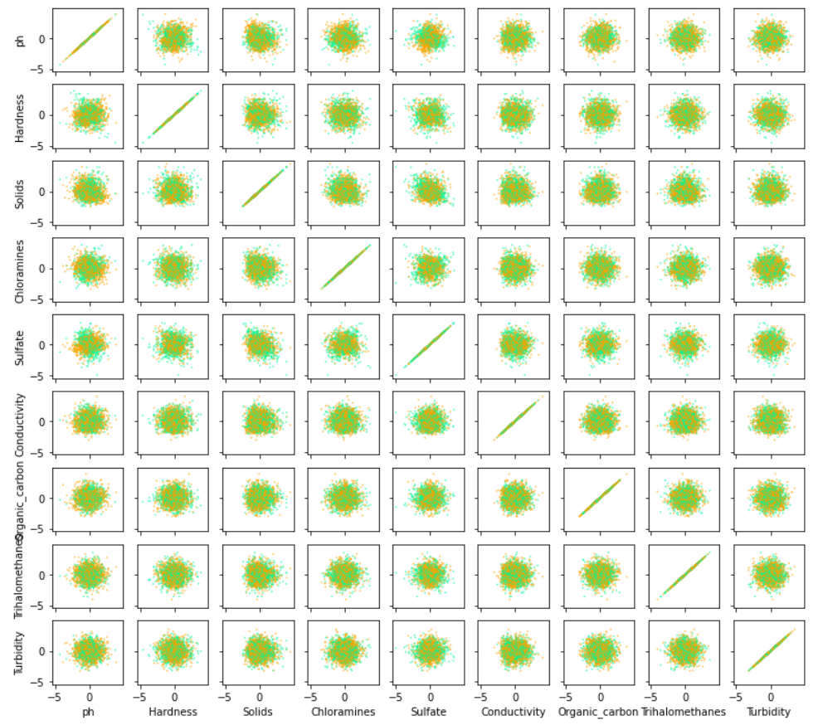
Reducing Features – Business Rules
Pairs of Features
Orange - Impotable
Blue - Potable
Ph and Sulfate, Chloramines

Slide 8
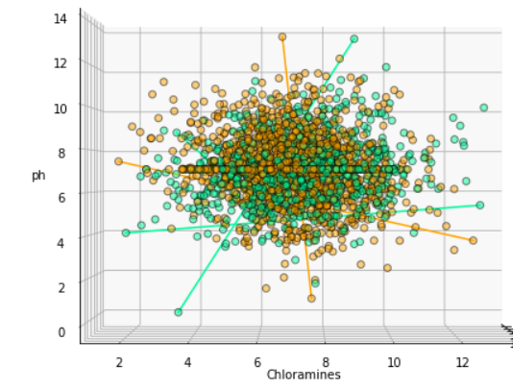
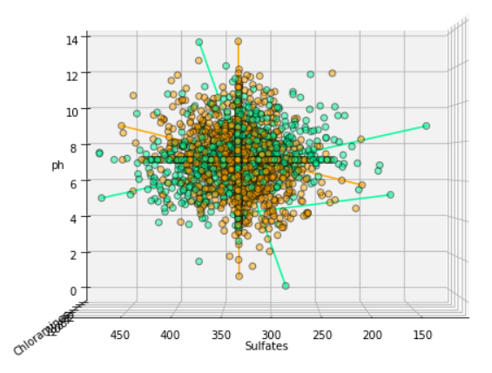
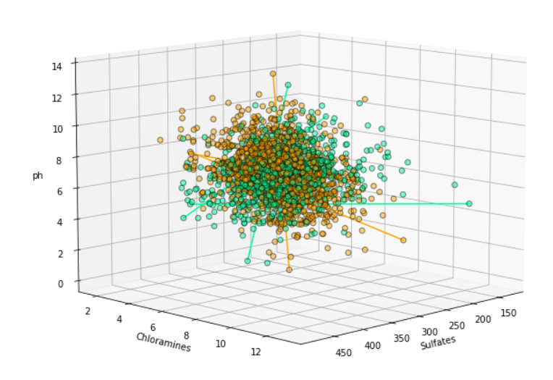
3d ph sulfates chloramines

Slide 9
Models Comparison
15 Models
Manual Tuning
Grid Searched Tuning
Reduce False Positives - poison
Recall at Cost of Accuracy, Precision

Slide 10
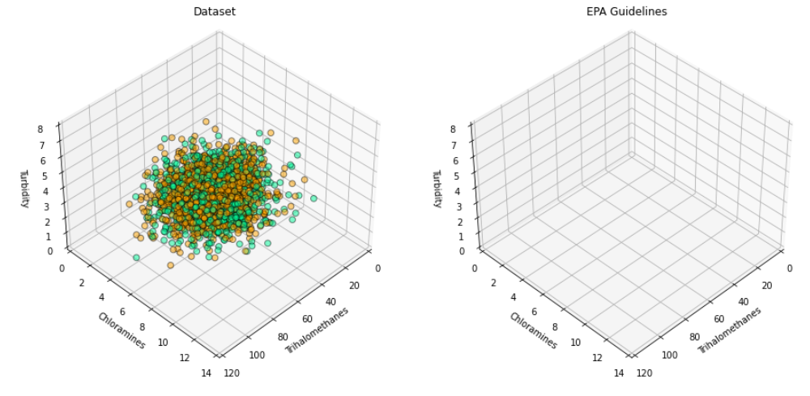
EPA Guidelines

Slide 11
Next Steps
Different Features
More info about potability column
Filtration?
Other Treatment

Slide 12
Q&A
Github Link

